Slide 1
25
Templates

Slide 2
OBJECTIVES
In this chapter you will learn:
To use function templates to conveniently create a group of related (overloaded) functions.
To distinguish between function templates and function-template specializations.
To use class templates to create a group of related types.
To distinguish between class templates and class-template specializations.
To overload function templates.

Slide 3
25.1 Introduction
25.2 Function Templates
25.3 Overloading Function Templates
25.4 Class Templates
25.5 Nontype Parameters and Default Types for Class Templates

Slide 4
25.1 Introduction
Generic programming
  Writing code in a way that is independent of any particular data type
Templates are the foundation of generic programming
Function templates and class templates
  Enable programmers to specify an entire range of related functions and related classes
    Called function-template specializations and class-template specializations, respectively
  A template is a blueprint for creating a function or a class
  E.g, vector is a template class in C++ standard library
    vector<int>, vector<string> are classes generated from the vector template

Slide 5
25.1 Introduction
Example of function template
int compare(const string &v1, const string &v2) {
if (v1 < v2) return -1;
if (v2 < v1) return 1;
return 0;
}
int compare(const double &v1, const double &v2) {
if (v1 < v2) return -1;
if (v2 < v1) return 1;
return 0;
}
template <typename T>
int compare(const T &v1, const T &v2) {
if (v1 < v2) return -1;
if (v2 < v1) return 1;
return 0;
}
cout << compare(1, 0) << endl;
string s1 = “hi”, s2 = “world”;
cout << compare(s1, s2) << endl;

Slide 6
25.2 Function Templates
Function Templates
  Used to produce overloaded functions that perform identical operations on different types of data
    Programmer writes a single function-template definition
    Compiler generates separate object-code functions (function-template specializations) based on argument types in calls to the function template
  Similar to macros in C, but with full type checking

Slide 7
25.2 Function Templates (Cont.)
Function-template definitions
  Preceded by a template header
    Keyword template
    template parameter list
      Enclosed in angle brackets (< and >)
      Each template parameter is preceded by keyword class or keyword typename (both are interchangeable)
      Used to specify types of arguments to, local variables in and return type of the function template
    Examples
      template< typename T >
      template< class ElementType >
      template< typename BorderType, typename Filltype >

Slide 8
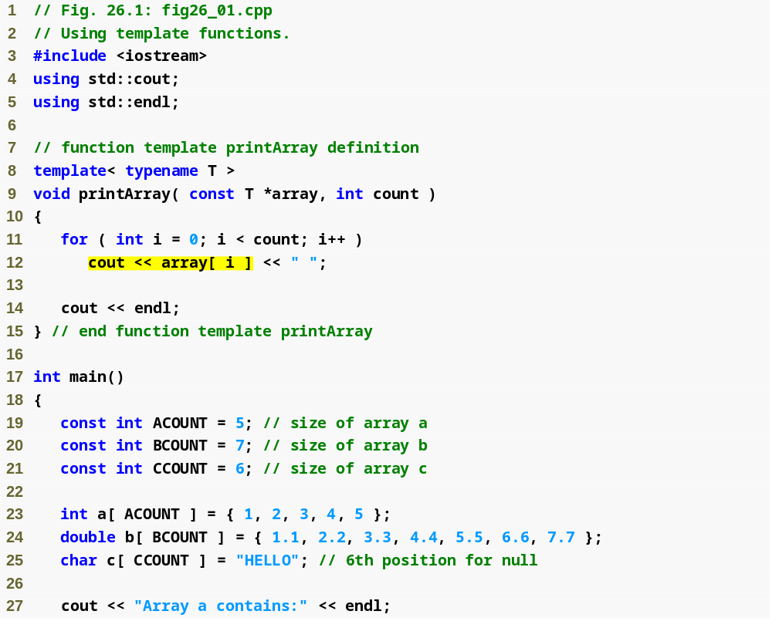
Outline
Type template parameter T specified in template header
fig26_01.cpp
(1 of 2)

Slide 9
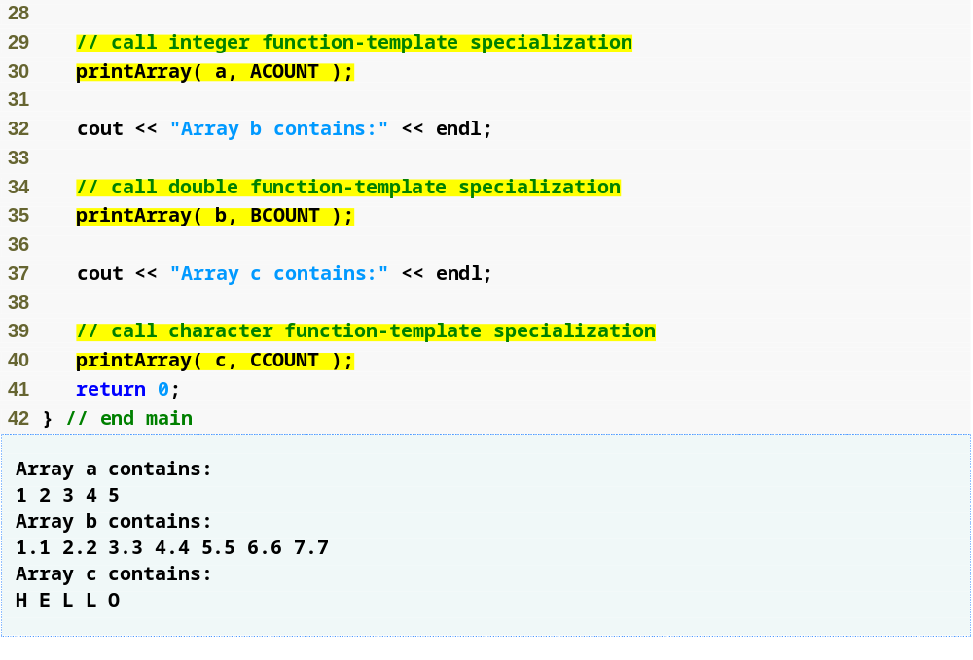
Outline
Creates a function-template specialization of printArray where int replaces T
fig26_01.cpp
(2 of 2)
Creates a function-template specialization of printArray where double replaces T
Creates a function-template specialization of printArray where char replaces T

Slide 10
Common Programming Error 26.2
If a template is invoked with a user-defined type, and if that template uses functions or operators (e.g., ==, +, <=) with objects of that class type, then those functions and operators must be overloaded for the user-defined type. Forgetting to overload such operators causes compilation errors.

Slide 11
Performance Tip 25.1
Although templates offer software-reusability benefits, remember that multiple function-template specializations and class-template specializations are instantiated in a program (at compile time), despite the fact that the template is written only once. These copies can consume considerable memory.
This is not normally an issue, though, because the code generated by the template is the same size as the code the programmer would have written to produce the separate overloaded functions.

Slide 12
25.3 Overloading Function Templates
A function template may be overloaded
  Other function templates that specify the same name but different parameters
  Nontemplate functions that specify the same name but different parameters
  The compiler chooses the best function or specialization to match the function call
    A nontemplate function is chosen over a template specialization in case of a tie
    Otherwise, multiple matches results in a compilation error (the compiler considers the function call to be an ambiguous function call )

Slide 13
Common Programming Error 26.3
If no matching function definition can be found for a particular function call, or if there are multiple matches, the compiler generates an error.

Slide 14
25.4 Class Templates
Class templates
  Class-template definitions are preceded by a header
    Such as template< typename T >
  Type parameter T can be used as a data type in member functions and data members
  Additional type parameters can be specified using a comma-separated list
    As in template< typename T1, typename T2 >

Slide 15
Software Engineering Observation 26.2
Class templates encourage software reusability by enabling type-specific versions of generic classes to be instantiated.
E.g., a stack is a general data structure, which can be used to hold integers, or strings.
Given a class template of stack, we are able to create many stack classes such as “stack of int”, “stack of double”, “stack of string”, etc.

Slide 16
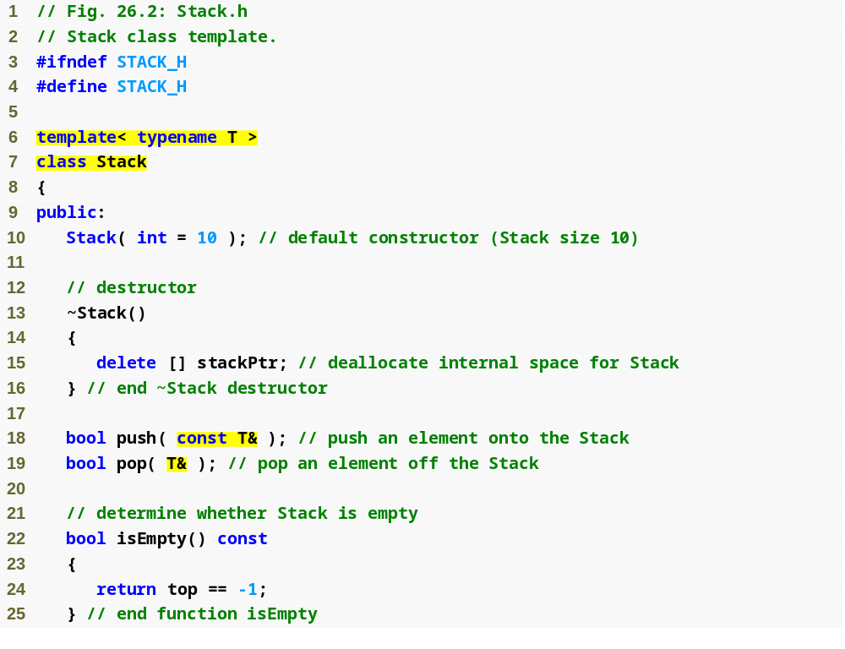
Outline
Stack.h
(1 of 3)
Create class template Stack with type parameter T
Member functions that use type parameter T in specifying function parameters

Slide 17
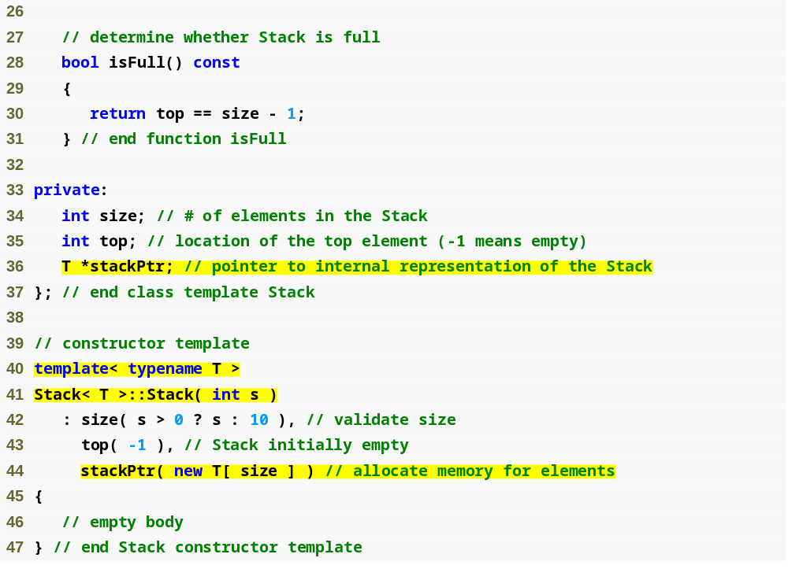
Outline
Stack.h
(2 of 3)
Data member stackPtr is a pointer to a T
Member-function template definitions that appear outside the class-template definition begin with the template header

Slide 18
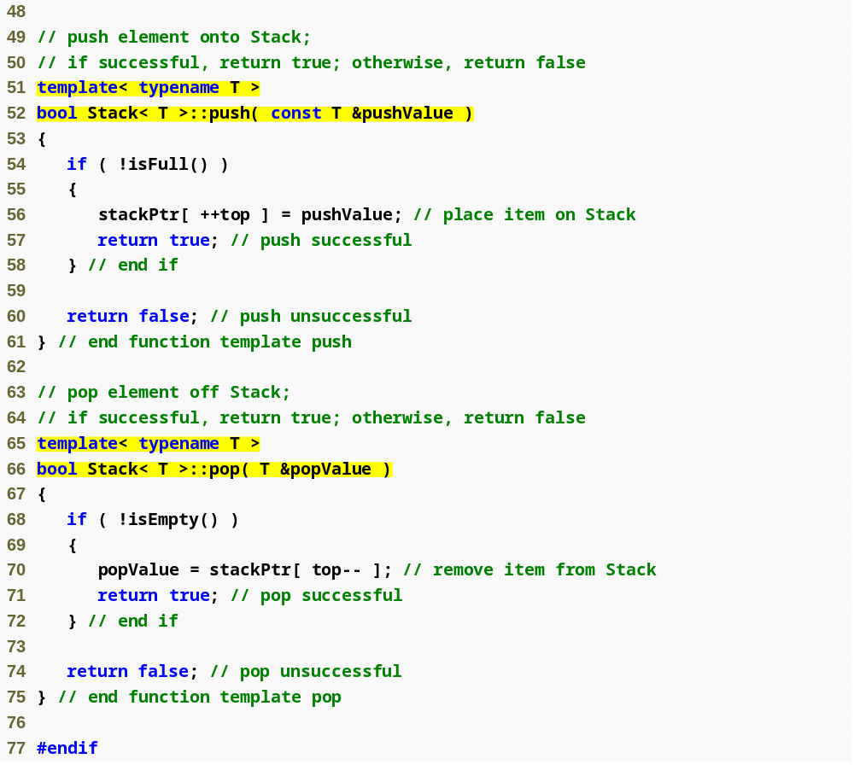
Outline
Stack.h
(3 of 3)

Slide 19
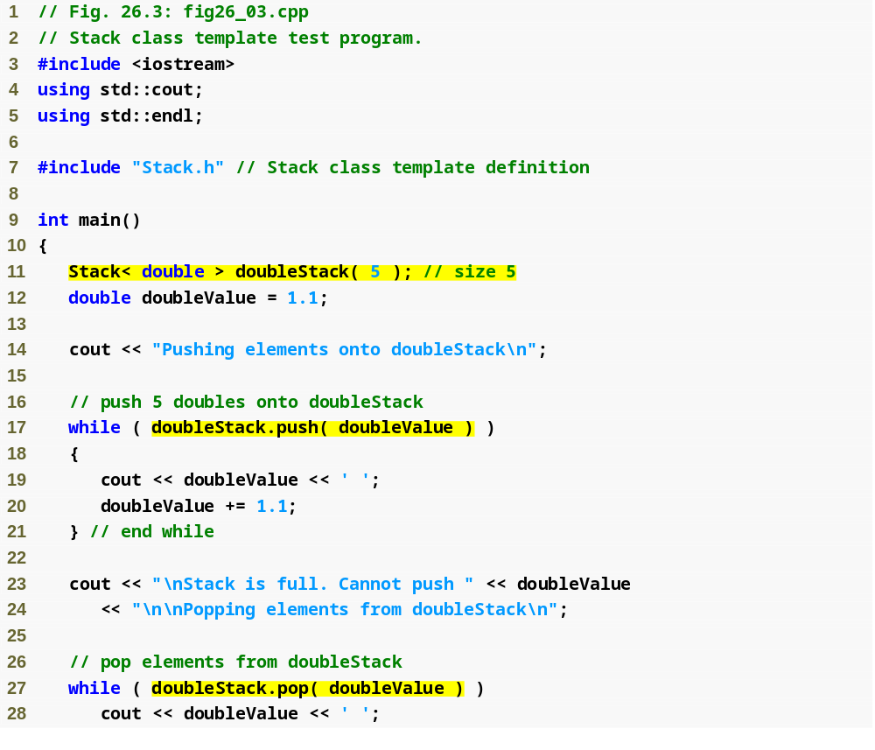
Outline
fig26_03.cpp
(1 of 3)
Create class-template specialization Stack< double > where type double is associated with type parameter T

Slide 20
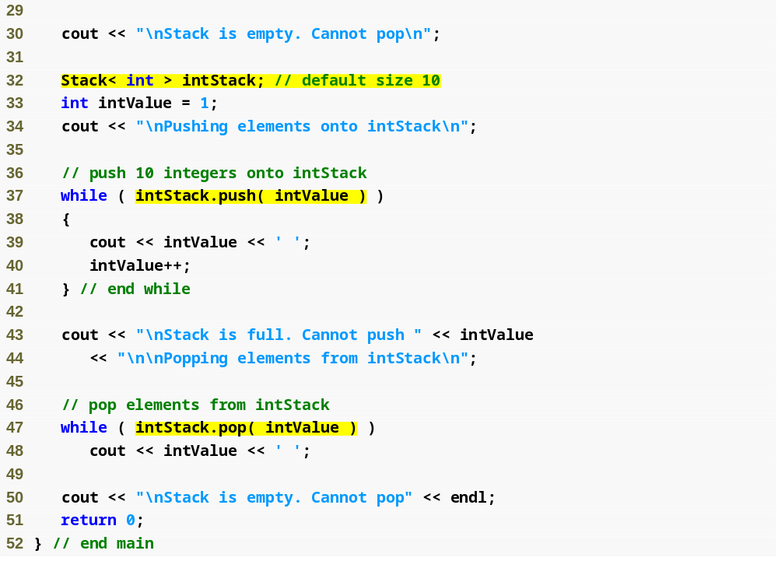
Outline
fig26_03.cpp
(2 of 3)
Create class-template specialization Stack< int > where type int is associated with type parameter T

Slide 21
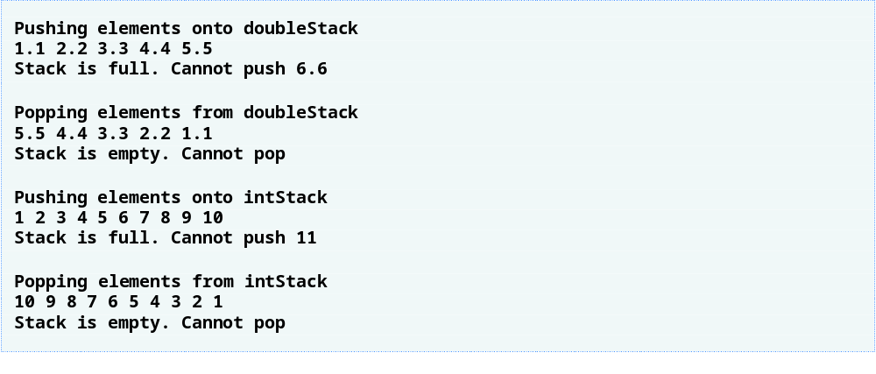
Outline
fig26_03.cpp
(3 of 3)

Slide 22
Standard Template Library
The heart of the C++ standard library is the standard template library (STL).
STL is a generic library that provides solutions to managing collections of data with modern and efficient algorithms.
  It provides a bunch of collection classes that meet different needs, together with several algorithms that operate on them.
  All components of STL are templates, so they can be used for arbitrary element types.
STL components:
  Containers: used to manage collections of objects of a certain kind
  Iterators: used to step through the elements of collections of objects
  Algorithms: used to process the elements of collections, e.g., search, sort, modify, etc. Algorithms use iterators.

Slide 23
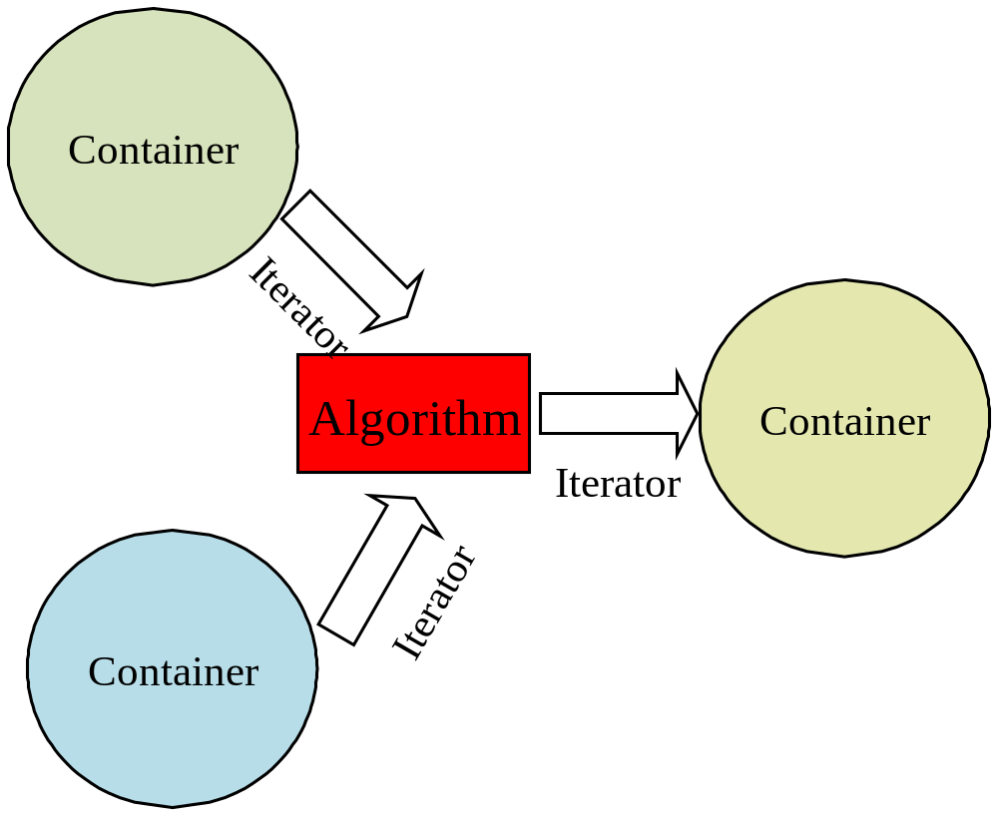
Standard Template Library

Slide 24
Library vector type
A vector is an ordered collection of objects of a single type, each of which has an associated integer index
  vector is one example of container because it contains other objects.
  It provides random access, like array in C.
  It provides good performance if you append or delete elements at the end
vector is a class template
E.g., vector<int>, vector<string>, etc.
#include <vector>
using std::vector;

Slide 25
Define and initialize vectors
Ways to initialize vector
vector<T> v1; | vector that holds objects of type T;
vector<T> v2(v1); | v2 is a copy of v1
vector<T> v3(n, i); | v3 has n elements with value i
vector<T> v4(n); | v4 has n copies of a value-initialized object

Slide 26
vector operations
v.empty() | Returns true if v is empty; otherwise returns false
v.size() | Returns number of elements in v
v.capacity() | Returns the maximum possible number of elements without reallocation
v.max_size() | Returns the maximum number of elements possible
v.reserve() | Enlarges capacity, if not enough yet
v[n], v.at(n) | Returns the element at position n in v
v.front(), v.back() | Returns the first (last) element
v1 = v2 | Replaces elements in v1 by a copy of elements in v2
v1 == v2 | Returns true if v1 and v2 are equal
!=, <, <=, >, >= | Have their normal meanings

Slide 27
Insert and Remove Operations
v.insert(pos, elem) | Inserts at iterator position pos a copy of elem and returns the position of the new element
v.insert(pos, n, elem) | Inserts at iterator position pos n copies of elem
v.push_back(t) | Adds element with value t to end of v
v.pop_back() | Removes the last element
v.erase(pos) | Removes the element at iterator position pos and returns the position of the next element
v.erase(beg, end) | Removes all elements of the range [beg, end) and returns the position of the next element
v.clear() | Removes all elements

Slide 28
Iterator Functions
c.begin() | Returns a random access iterator for the first element
c.end() | Returns a random access iterator for the position after the last element
c.rbegin() | Returns a reverse iterator for the first element of a reverse iteration
c.rend() | Returns a reverse iterator for the position after the last element of a reverse iteration

Slide 29
Example 1
#include <iostream>
#include <vector>
#include <algorithm>
using namespace std;
int main()
{
vector<int> coll;
vector<int>::iterator pos;
coll.push_back(2);
coll.push_back(5);
coll.push_back(4);
coll.push_back(1);
coll.push_back(6);
coll.push_back(3);
pos = min_element(coll.begin(), coll.end());
cout << “min: ” << *pos << endl;
pos = max_element(coll.begin(), coll.end());
cout << “max: ” << *pos << endl;
sort(coll.begin(), coll.end());
pos = find(coll.begin(), coll.end(), 3);
reverse(pos, coll.end());
for (pos = coll.begin; pos!=coll.end(); ++pos) {
cout << *pos << ‘ ’;
}
cout << endl;
return 0;
}

Slide 30
Example 2
#include <iostream>
#include <vector>
#include <string>
#include <algorithm>
#include <iterator>
using namespace std;
int main()
{
vector<string> sentence;
sentence.reserve(5);
sentence.push_back("Hello,");
sentence.push_back("how");
sentence.push_back("are");
sentence.push_back("you");
sentence.push_back("?");
copy(sentence.begin(), sentence.end(), ostream_iterator<string>(cout, " "));
cout << endl;

Slide 31
Example 2 (cont.)
cout << " max_size(): " << sentence.max_size() << endl;
cout << " size(): " << sentence.size() << endl;
cout << " capacity(): " << sentence.capacity() << endl;
swap(sentence[1], sentence[3]);
sentence.insert(find(sentence.begin(), sentence.end(), "?"), "always");
sentence.back() = "!";
copy(sentence.begin(), sentence.end(), ostream_iterator<string>(cout, " "));
cout << endl;
cout << " max_size(): " << sentence.max_size() << endl;
cout << " size(): " << sentence.size() << endl;
cout << " capacity(): " << sentence.capacity() << endl;
}

